Slide 1

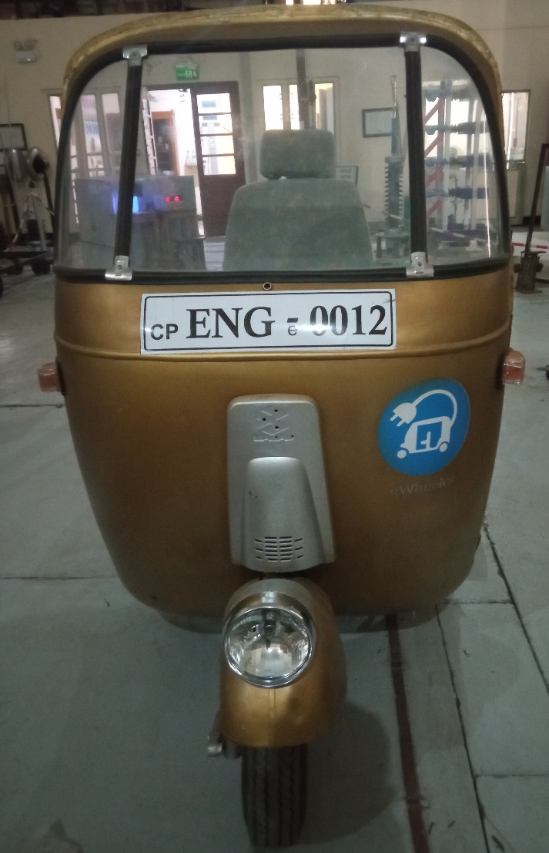
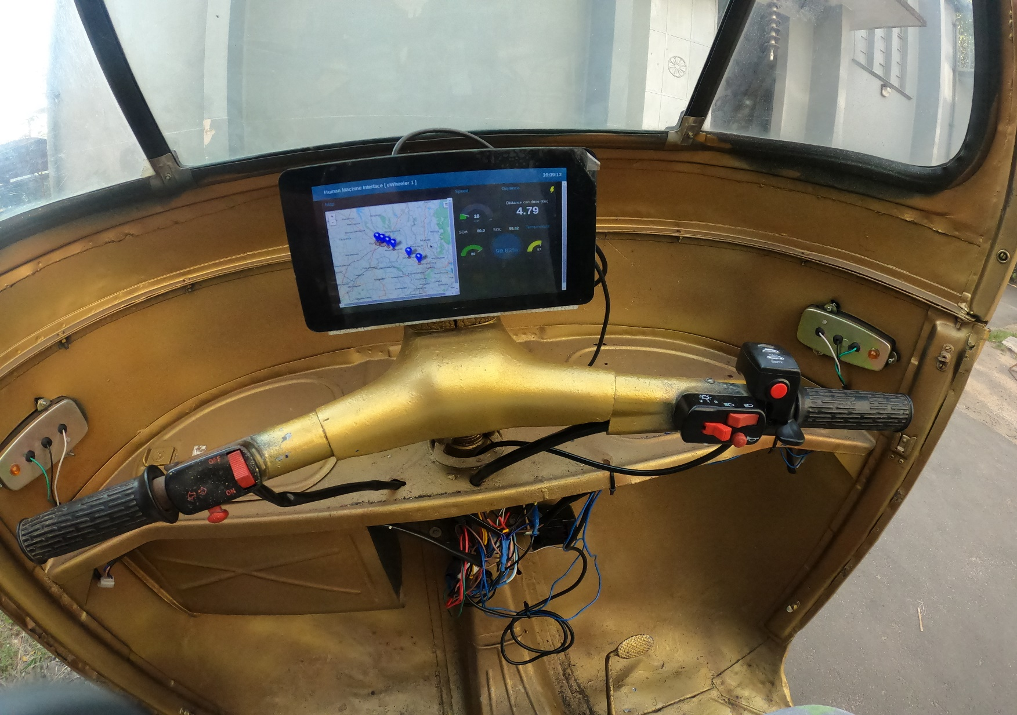
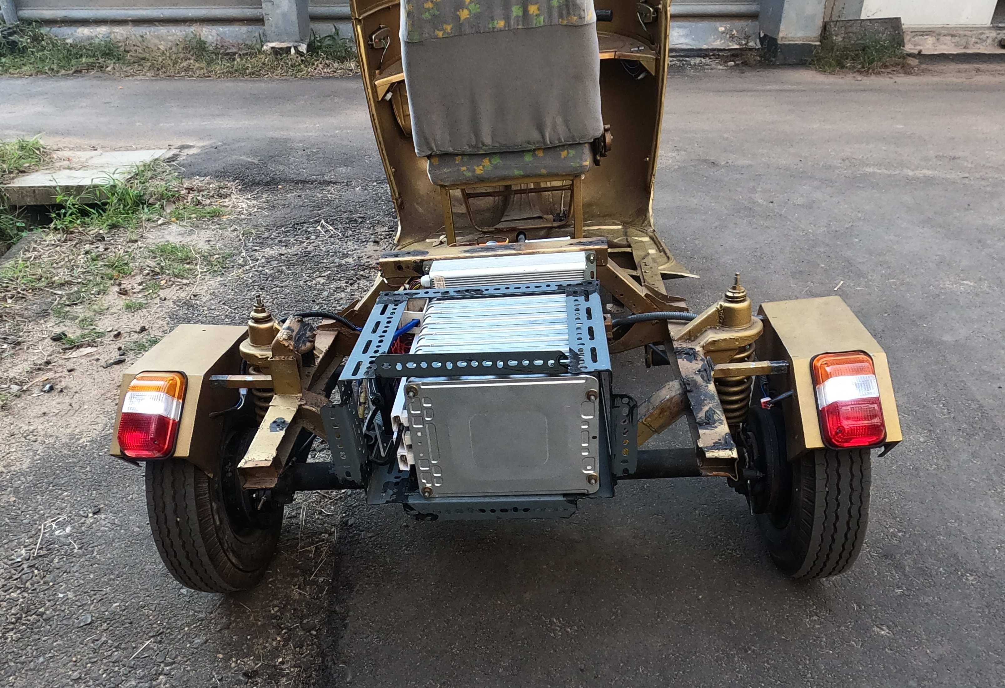
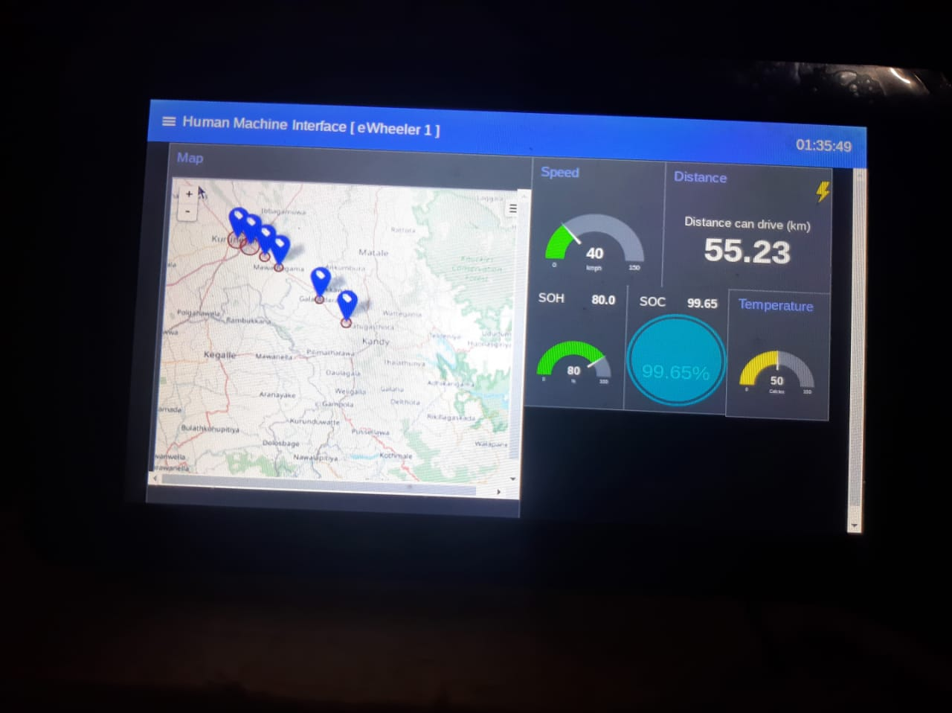

Peradeniya University Research Excellence Showcase
PURES
Electric Three-Wheeler with Battery Sweeping Method
Anjana Pathirana, Avinash Divakarn, Lilantha Samaranayake, Janaka Ekanayake
Department of Electrical & Electronic Engineering, Faculty of Engineering
Abstract - A traditional internal combustion engine driven three-wheeler (tuk-tuk) has been converted to an electric three-wheeler known as e-Wheeler. It is powered by a Lithium-Ion battery with swapping capability, which avoids range anxiety. The remaining range depending on the battery state-of-charge (SOC) is estimated in real time and displayed in the digital dashboard of the e-Wheeler. The speed of the vehicle, the battery temperature and the battery state-of-health (SOH) are also calculated, measured and estimated respectively and displayed in the same dashboard. In addition, the driver is updated with the nearby battery swapping stations using IoT technology onboard communicated via the dashboard using mobile telecommunication network available. With a 50% SOH battery, the e-Wheeler range is 35 km per charge on a flat terrain. With 100% SOH, it is anticipated to have over 60 km range.
Motor Specifications
Battery Specifications
Motor type | Brushless DC motor
Voltage | 60 V
Power | 3000 W
Phase | Dual mode
The used Nissan Leaf 8 battery modules is used for the battery pack.
Battery capacity | 30Ah (Original capacity – 65Ah)
Module count | 8
Cells in one module | 2 parallel and 2 series
Maximum cell voltage | 4.2 V
Minimum cell voltage (Setting in BMS for protections) | 3.0 V
Using BMS type | JK – BMS (JK-BD6A20S10P)
Display Features
Test run results
The algorithms are developed to display following features in the display.
According to the test run, about 35km can be drive from one battery charge (Using 32.5 Ah battery with full charge). Test run is done on a flat terrain.
Speed (km/h)
Range (km)
Battery SOC %
Battery SOH %
Distance travelled (km)
Nearest charging station (In a Map)
Battery Temperature (⁰C)
Battery Voltage (V)
Battery Current (A)
Vehicle tilt angle
Key Features
Battery sweeping mechanism
A special arrangement is invented for battery swapping. The power and the communication cable connections can be easily connected and disconnected with this arrangement safely and reliably.
Real-Time Range Estimator
The basic concept is to compare the battery's remaining SOC with the energy required by the vehicle. The range can then be determined using an algorithm.
Range estimation is carried out using history and model based approach with the help of K-means algorithm. Energy consumption prediction done using extrapolation.
Funded by: Ceylex Engineering (Pvt.) Ltd.
Contact details
Name : Prof. Lilantha Samaranayake
Tel. No.: +94716848319
Email : lilantha@eng.pdn.ac.lk
Department of Electrical and Electronic Engineering
Faculty of Engineering
University of Peradeniya
Peradeniya, 20400, Sri Lanka
University of Peradeniya
Peradeniya, 20400, Sri Lanka

